Slide 1
Lecture 5 Sorting
Abrar Hasan
Lecturer
Dept. of Software Engineering
Daffodil International University

Slide 2
Table of contents
01
02
03
<
T
0
>
Introduction to Sorting
Bubble Sort
Time Complexity
Definition and Example of
Sorting algorithm
How Bubble Sort works
How efficient the algorithm is

Slide 3
01
Introduction
<
T
1
>
Brief Description about sorting

Slide 4

Sorting
<
T
1
>
Sorting Means to arrange the element of data structure to a specific order.

Slide 5
<
T
1
>
Example of Sorting Algorithm
Bubble Sort
Quick sort (Qsort)
Merge Sort
Insertion Sort
Radix Sort

Slide 6
<
T
1
>
Today We are going to study Bubble sort

Slide 7
02
Bubble Sort
<
T
2
>
Working Process and Functional Description

Slide 8
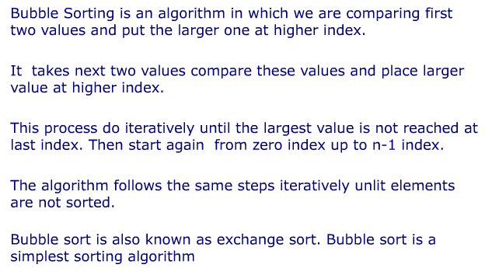
Bubble Sort
<
T
1
>

Slide 9
Bubble Sort
<
T
1
>
0
1
2
3
4
5
7
7
9
1
4
1
4
7
7
If (a[j]>a[j+1])
SWAP
9>1 == True
7>4 == true
7>9 == False
7>1 == true
7>4 == true

Slide 10
Code for bubble sort
<
T
1
>
for (i = 0 ; i < ( n - 1 ); i++)
{
for (j = 0 ; j < n - i - 1; j++)
{
if (array[j] > array[j+1])
{
int swap = array[d];
array[d] = array[d+1];
array[d+1] = swap;
}
}
}

Slide 11
03
Complexity
<
T
3
>
How efficient the algorithm is?

Slide 12
Time Complexity
<
T
3
>
for (i = 0 ; i < ( n - 1 ); i++)
{
for (j = 0 ; j < n - i - 1; j++)
{
}
}
O(n²)

Slide 13
<
T
3
>
Any Question?

Slide 14
Thank You
<
T
3
>

